Slide 1
19
Collections

Slide 2
I think this is the most extraordinary collection of talent, of human knowledge, that has ever been gathered together at the White House—with the possible exception of when Thomas Jefferson dined alone.
  John F. Kennedy
The shapes a bright container can contain!
  Theodore Roethke
Journey over all the universe in a map.
  Miguel de Cervantes
Not by age but by capacity is wisdom acquired.
  Titus Maccius Plautus
It is a riddle wrapped in a mystery inside an enigma.
  Winston Churchill

Slide 3
OBJECTIVES
In this chapter you will learn:
What collections are.
To use class Arrays for array manipulations.
To use the collections framework (prepackaged data structure) implementations.
To use collections framework algorithms to manipulate (such as search, sort and fill) collections.
To use the collections framework interfaces to program with collections polymorphically.
To use iterators to “walk through” a collection.
To use persistent hash tables manipulated with objects of class Properties.
To use synchronization and modifiability wrappers.

Slide 4
19.1 Introduction
19.2 Collections Overview
19.3 Class Arrays
19.4 Interface Collection and Class Collections
19.5 Lists
19.5.1 ArrayList and Iterator
19.5.2 LinkedList
19.5.3 Vector
19.6 Collections Algorithms
19.6.1 Algorithm sort
19.6.2 Algorithm shuffle
19.6.3 Algorithms reverse, fill, copy, max and min
19.6.4 Algorithm binarySearch
19.6.5 Algorithms addAll, frequency and disjoint

Slide 5
19.7 Stack Class of Package java.util
19.8 Class PriorityQueue and Interface Queue
19.9 Sets
19.10 Maps
19.11 Properties Class
19.12 Synchronized Collections
19.13 Unmodifiable Collections
19.14 Abstract Implementations
19.15 Wrap-Up

Slide 6
19.1 Introduction
Java collections framework
  Contain prepackaged data structures, interfaces, algorithms
  Use generics
  Use existing data structures
    Example of code reuse
  Provides reusable componentry

Slide 7
19.2 Collections Overview
Collection
  Data structure (object) that can hold references to other objects
Collections framework
  Interfaces declare operations for various collection types
  Provide high-performance, high-quality implementations of common data structures
  Enable software reuse
  Enhanced with generics capabilities in J2SE 5.0
    Compile-time type checking

Slide 8
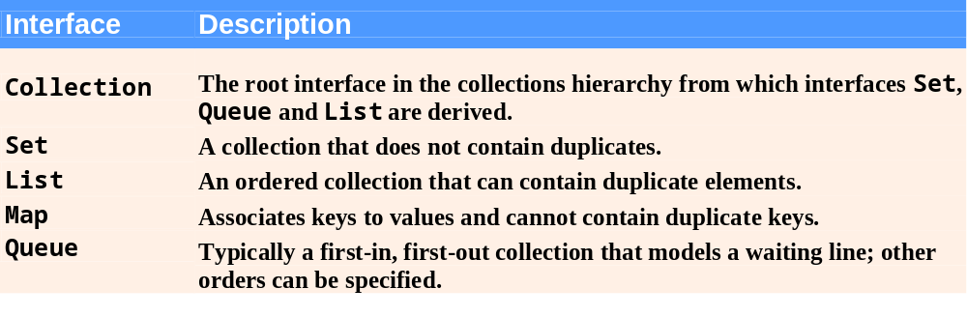
Fig. 19.1 | Some collection framework interfaces.

Slide 9
19.3 Class Arrays
Class Arrays
  Provides static methods for manipulating arrays
  Provides “high-level” methods
    Method binarySearch for searching sorted arrays
    Method equals for comparing arrays
    Method fill for placing values into arrays
    Method sort for sorting arrays

Slide 10
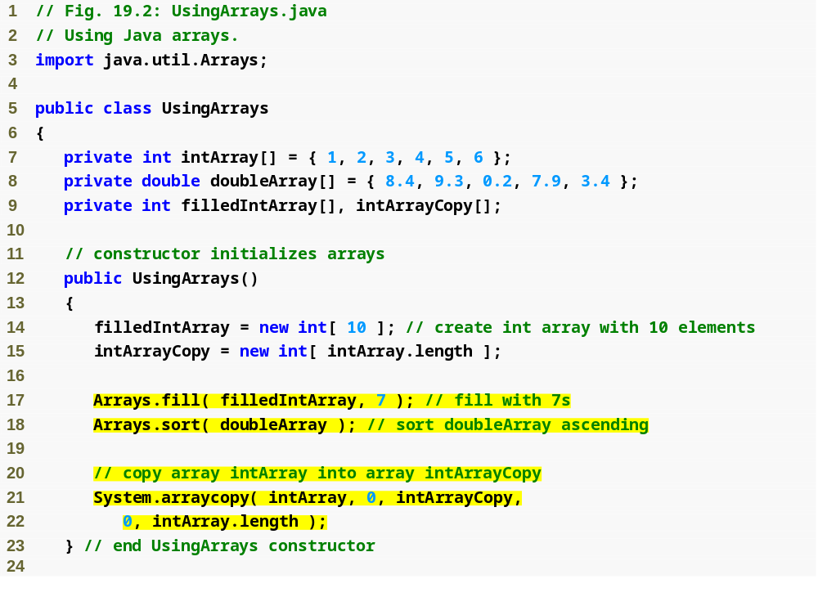
Use static method fill of class Arrays to populate array with 7s
Use static method sort of class Arrays to sort array’s elements in ascending order
Use static method arraycopy of class System to copy array intArray into array intArrayCopy

Slide 11
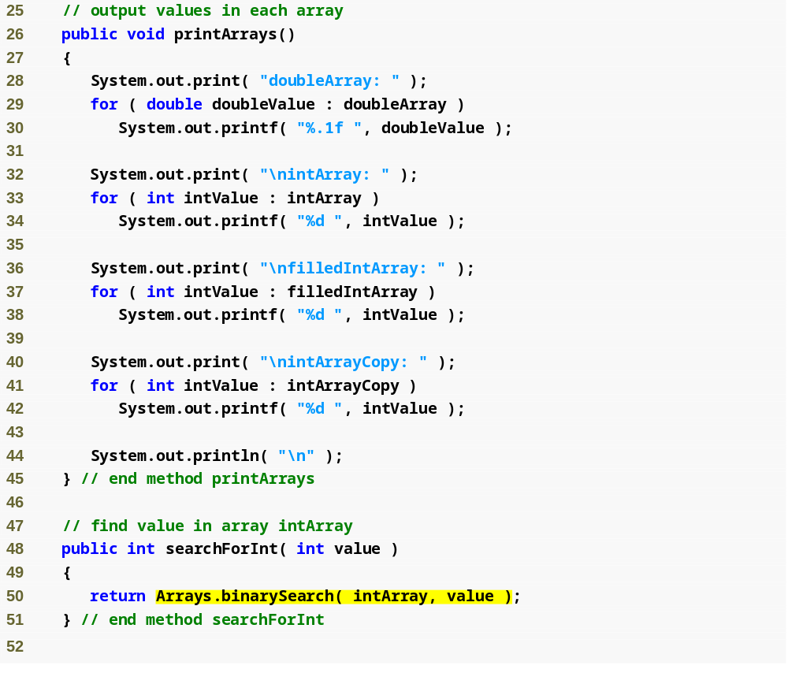
Use static method binarySearch of class Arrays to perform binary search on array

Slide 12
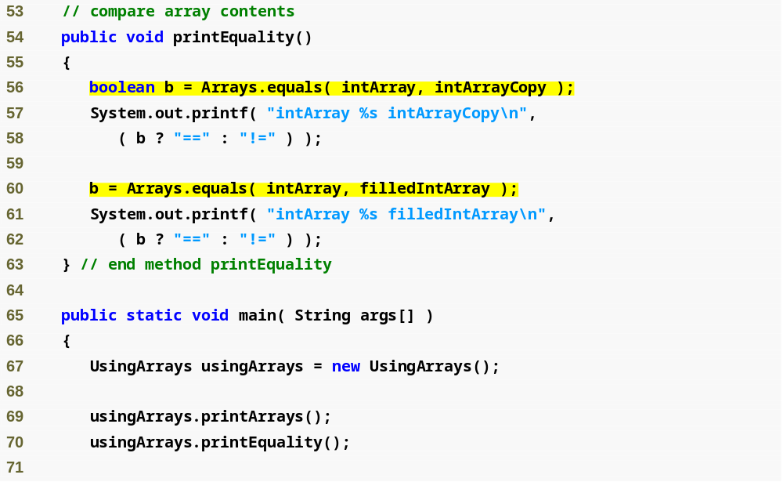
Use static method equals of class Arrays to determine whether values of the two arrays are equivalent

Slide 13
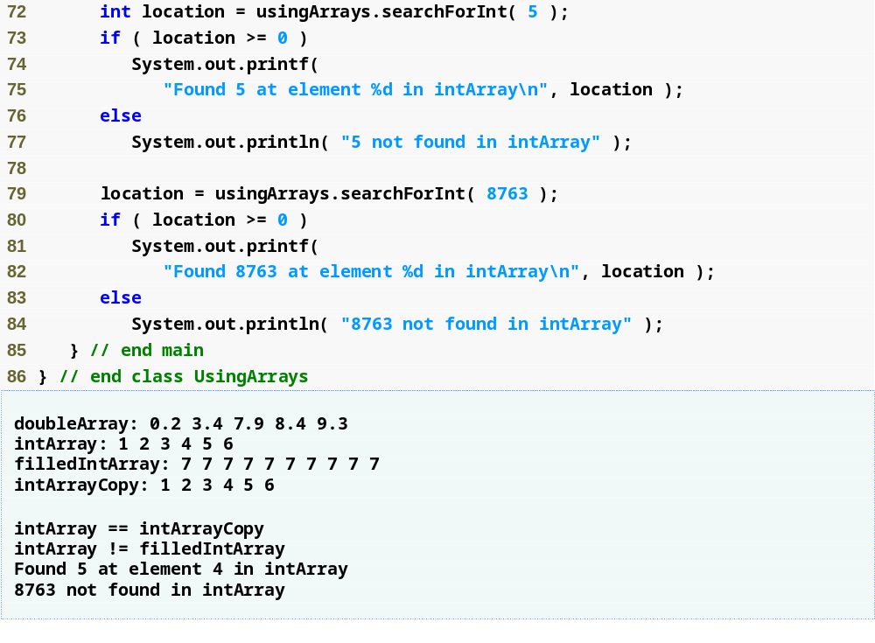

Slide 14
Common Programming Error 19.1
Passing an unsorted array to binarySearch is a logic error—the value returned is undefined.

Slide 15
19.4 Interface Collection and Class Collections
Interface Collection
  Root interface in the collection hierarchy
  Interfaces Set, Queue, List extend interface Collection
    Set – collection does not contain duplicates
    Queue – collection represents a waiting line
    List – ordered collection can contain duplicate elements
  Contains bulk operations
    Adding, clearing, comparing and retaining objects
  Provide method to return an Iterator object
    Walk through collection and remove elements from collection

Slide 16
Software Engineering Observation 19.1
Collection is used commonly as a method parameter type to allow polymorphic processing of all objects that implement interface Collection.

Slide 17
Software Engineering Observation 19.2
Most collection implementations provide a constructor that takes a Collection argument, thereby allowing a new collection to be constructed containing the elements of the specified collection.

Slide 18
19.4 Interface Collection and Class Collections (Cont.)
Class Collections
  Provides static methods that manipulate collections
    Implement algorithms for searching, sorting and so on
  Collections can be manipulated polymorphically
Synchronized collection
Unmodifiable collection

Slide 19
19.5 Lists
List
  Ordered Collection that can contain duplicate elements
  Sometimes called a sequence
  Implemented via interface List
    ArrayList
    LinkedList
    Vector

Slide 20
Performance Tip 19.1
ArrayLists behave like Vectors without synchronization and therefore execute faster than Vectors because ArrayLists do not have the overhead of thread synchronization.

Slide 21
Software Engineering Observation 19.3
LinkedLists can be used to create stacks, queues, trees and deques (double-ended queues, pronounced “decks”). The collections framework provides implementations of some of these data structures.

Slide 22
19.5.1 ArrayList and Iterator
ArrayList example
  Demonstrate Collection interface capabilities
  Place two String arrays in ArrayLists
  Use Iterator to remove elements in ArrayList

Slide 23
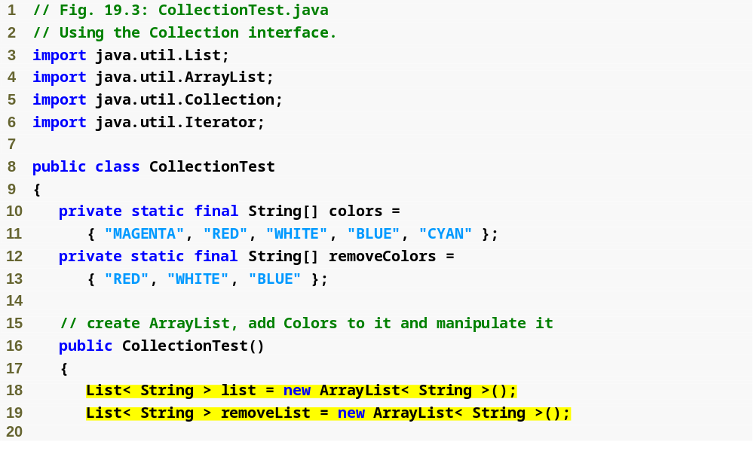
Create ArrayList objects and assign their references to variable list and removeList, respectively

Slide 24
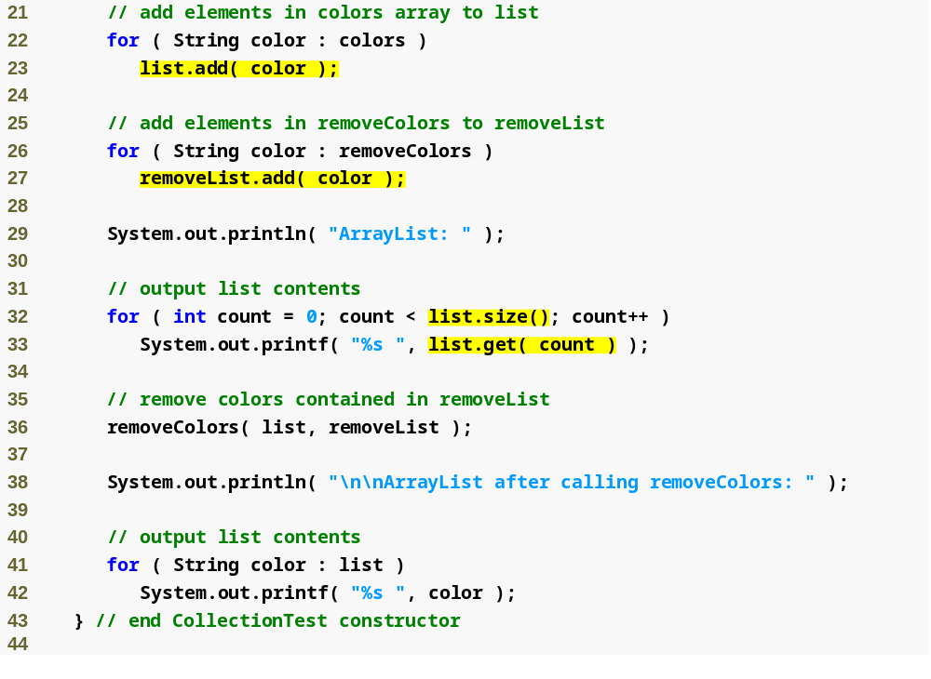
Use List method add to add objects to list and removeList, respectively
Use List method size to get the number of ArrayList elements
Use List method get to retrieve individual element values
Method removeColors takes two Collections as arguments; Line 36 passes two Lists, which extends Collection, to this method

Slide 25
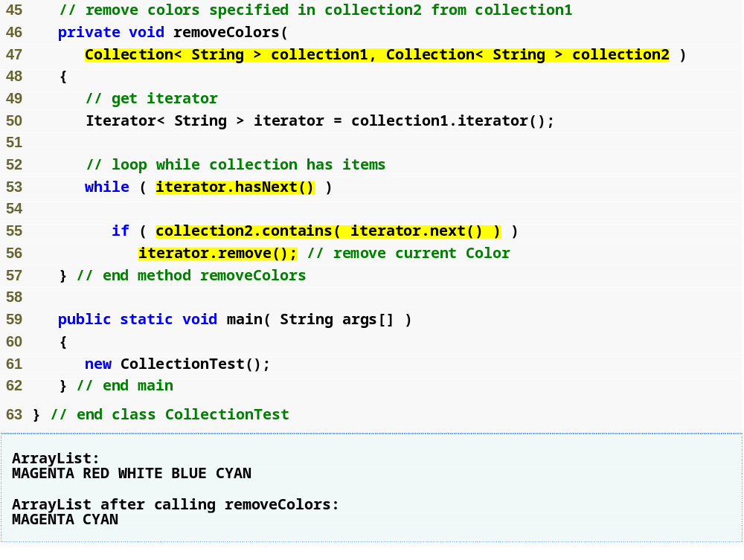
Method removeColors allows any Collections containing strings to be passed as arguments to this method
Obtain Collection iterator
Iterator method hasNext determines whether the Iterator contains more elements
Iterator method next returns a reference to the next element
Collection method contains determines whether collection2 contains the element returned by next
Use Iterator method remove to remove String from Iterator

Slide 26
Common Programming Error 19.2
If a collection is modified by one of its methods after an iterator is created for that collection, the iterator immediately becomes invalid—any operations performed with the iterator after this point throw ConcurrentModificationExceptions. For this reason, iterators are said to be “fail fast.”

Slide 27
19.5.2 LinkedList
LinkedList example
  Add elements of one List to the other
  Convert Strings to uppercase
  Delete a range of elements

Slide 28
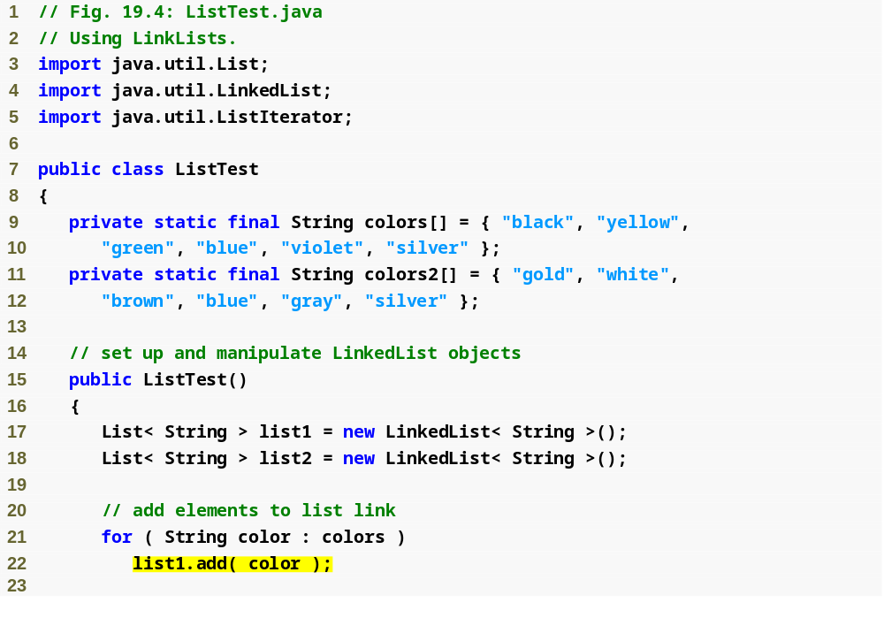
Create two LinkedList objects
Use List method add to append elements from array colors to the end of list1

Slide 29
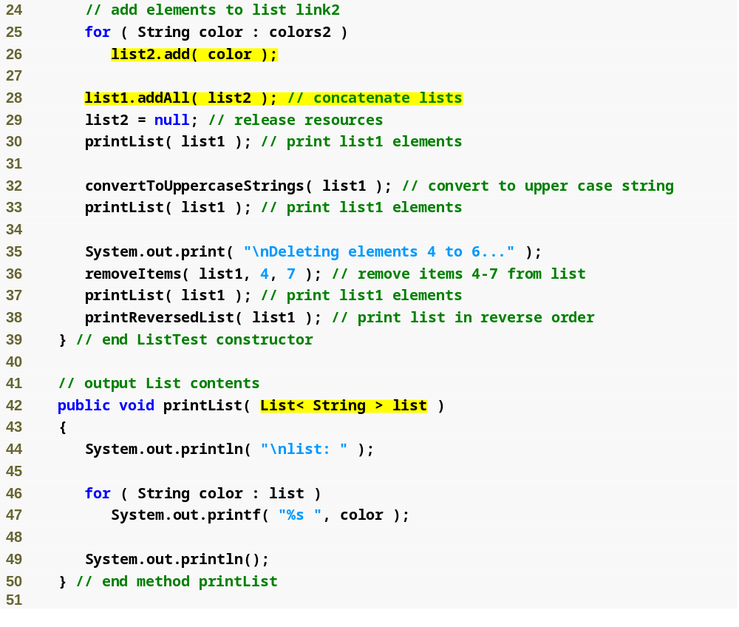
Use List method add to append elements from array colors2 to the end of list2
Use List method addAll to append all elements of list2 to the end of list1
Method printList allows any Lists containing strings to be passed as arguments to this method

Slide 30
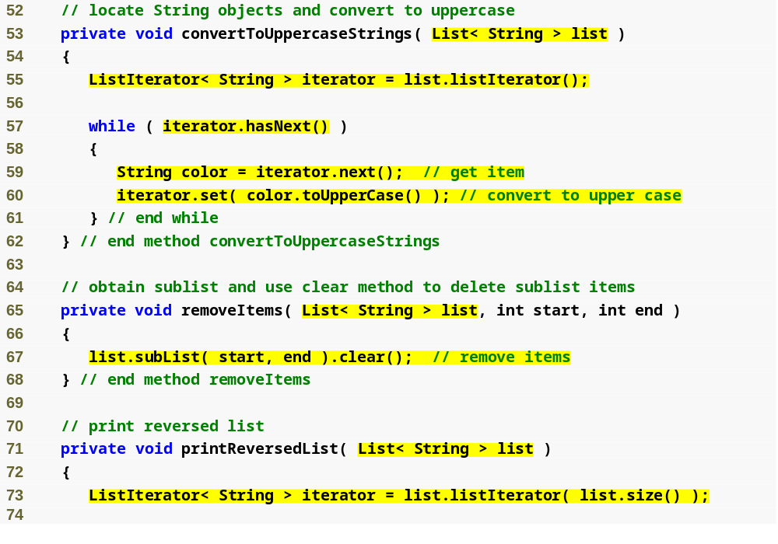
Method convertToUppercaseStrings allows any Lists containing strings to be passed as arguments to this method
Invoke List method listIterator to get a bidirectional iterator for the List
Invoke ListIterator method hasNext to determine whether the List contains another element
Invoke ListIterator method next to obtain the next String in the List
Invoke ListIterator method set to replace the current String to which iterator refers with the String returned by method toUpperCase
Method removeItems allows any Lists containing strings to be passed as arguments to this method
Invoke List method subList to obtain a portion of the List
Method printReversedList allows any Lists containing strings to be passed as arguments to this method
Invoke List method listIterator with one argument that specifies the starting position to get a bidirectional iterator for the list

Slide 31
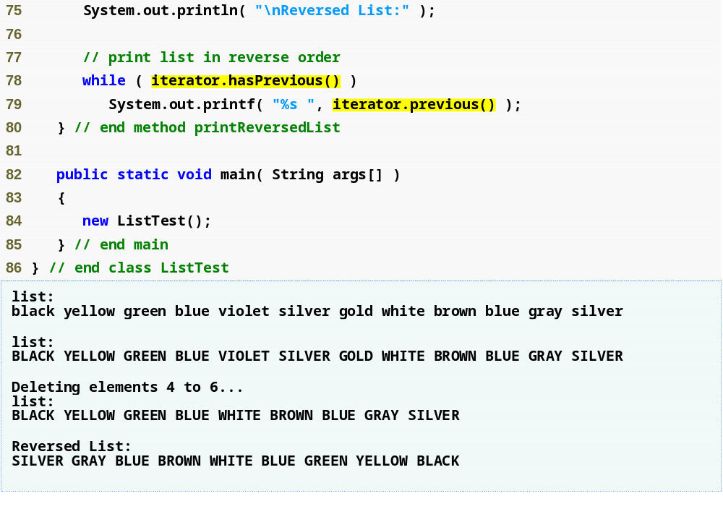
The while condition calls method hasPrevious to determine whether there are more elements while traversing the list backward
Invoke ListIterator method previous to get the previous element from the list

Slide 32
19.5.2 Linkedlist (Cont.)
static method asList of class Arrays
  View an array as a List collection
  Allow programmer to manipulate the array as if it were a list
  Any modification made through the List view change the array
  Any modification made to the array change the List view

Slide 33
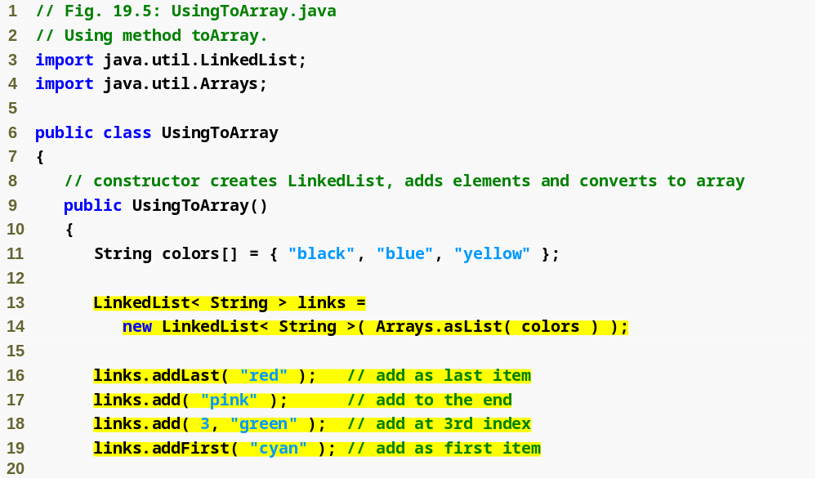
Call method asList to create a List view of array colors, which is then used for creating a LinkedList
Call LinkedList method addLast to add “red” to the end of links
Call LinkedList method add to add “pink” as the last element and “green” as the element at index 3
Call LinkedList method addFirst to add “cyan” as the new first item in the LinkedList

Slide 34
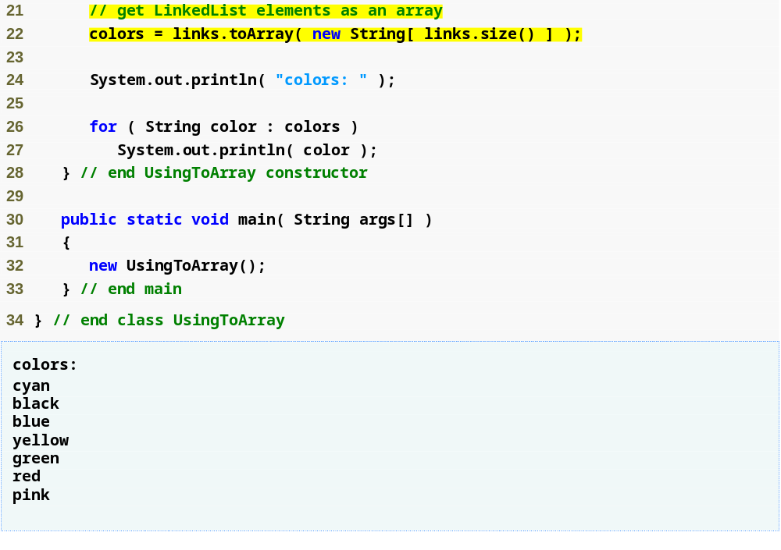
Use List method toArray to obtain array representation of LinkedList

Slide 35
Common Programming Error 19.3
Passing an array that contains data to toArray can cause logic errors. If the number of elements in the array is smaller than the number of elements in the list on which toArray is called, a new array is allocated to store the list’s elements—without preserving the array argument’s elements. If the number of elements in the array is greater than the number of elements in the list, the elements of the array (starting at index zero) are overwritten with the list’s elements. Array elements that are not overwritten retain their values.

Slide 36
19.5.3 Vector
Class Vector
  Array-like data structures that can resize themselves dynamically
  Contains a capacity
  Grows by capacity increment if it requires additional space

Slide 37
Performance Tip 19.2
Inserting an element into a Vector whose current size is less than its capacity is a relatively fast operation.

Slide 38
Performance Tip 19.3
Inserting an element into a Vector that needs to grow larger to accommodate the new element is a relatively slow operation.

Slide 39
Performance Tip 19.4
The default capacity increment doubles the size of the Vector. This may seem a waste of storage, but it is actually an efficient way for many Vectors to grow quickly to be “about the right size.” This operation is much more efficient than growing the Vector each time by only as much space as it takes to hold a single element. The disadvantage is that the Vector might occupy more space than it requires. This is a classic example of the space–time trade-off.

Slide 40
Performance Tip 19.5
If storage is at a premium, use Vector method trimToSize to trim a Vector’s capacity to the Vector’s exact size. This operation optimizes a Vector’s use of storage. However, adding another element to the Vector will force the Vector to grow dynamically (again, a relatively slow operation)—trimming leaves no room for growth.

Slide 41
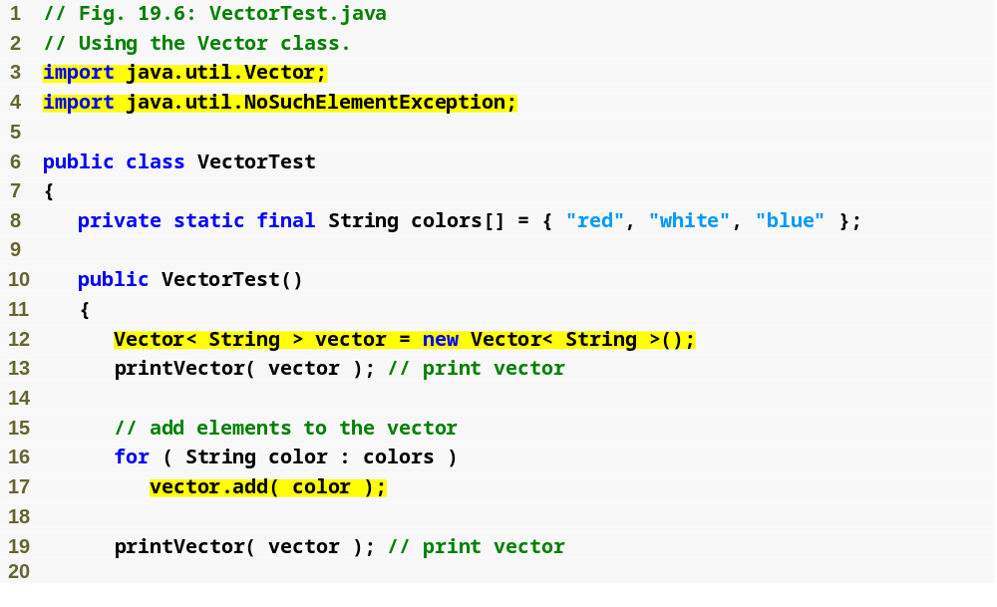
Create Vector of type String with initial capacity of 10 element and capacity increment of zero
Call Vector method add to add objects (Strings in this example) to the end of the Vector

Slide 42
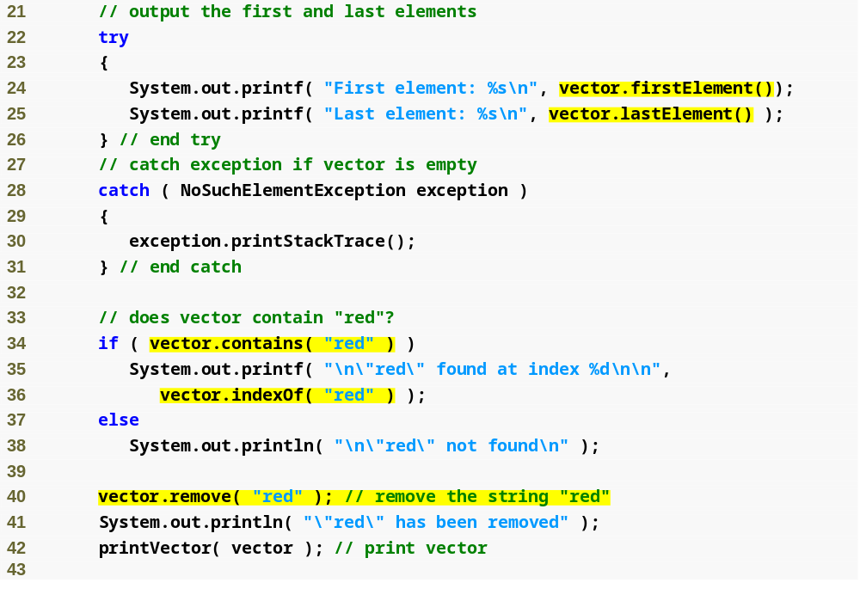
Call Vector method firstElement to return a reference to the first element in the Vector
Call Vector method lastElement to return a reference to the last element in the Vector
Vector method contains returns boolean that indicates whether Vector contains a specific Object
Vector method remove removes the first occurrence of its argument Object from Vector
Vector method indexOf returns index of first location in Vector containing the argument

Slide 43
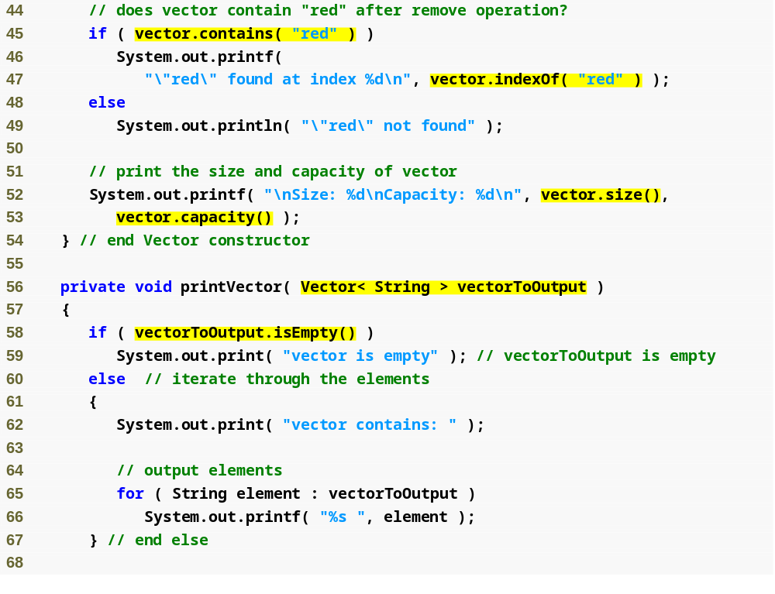
Vector methods size and capacity return number of elements in Vector and Vector capacity, respectively
Method printVector allows any Vectors containing strings to be passed as arguments to this method
Vector method isEmpty returns true if there are no elements in the Vector

Slide 44
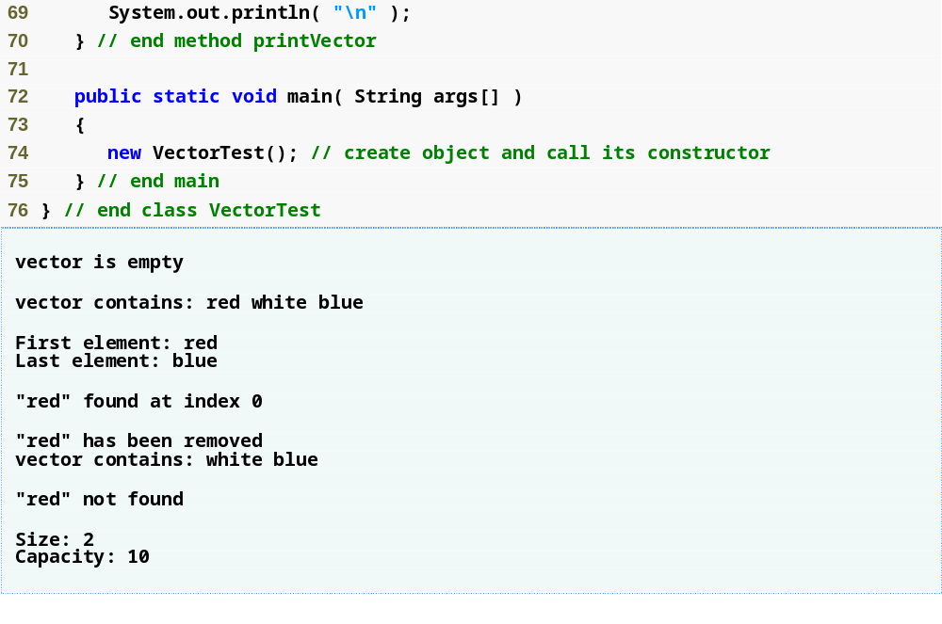

Slide 45
Common Programming Error 19.4
Without overriding method equals, the program performs comparisons using operator == to determine whether two references refer to the same object in memory.

Slide 46
Performance Tip 19.6
Vector methods contains and indexOf perform linear searches of a Vector’s contents. These searches are inefficient for large Vectors. If a program frequently searches for elements in a collection, consider using one of the Java Collection API’s Map implementations (Section 19.10), which provide high-speed searching capabilities.

Slide 47
19.6 Collections Algorithms
Collections framework provides set of algorithms
  Implemented as static methods
    List algorithms
      sort
      binarySearch
      reverse
      shuffle
      fill
      copy

Slide 48
19.6 Collections Algorithms
    Collection algorithms
      min
      max
      addAll
      frequency
      disjoint

Slide 49
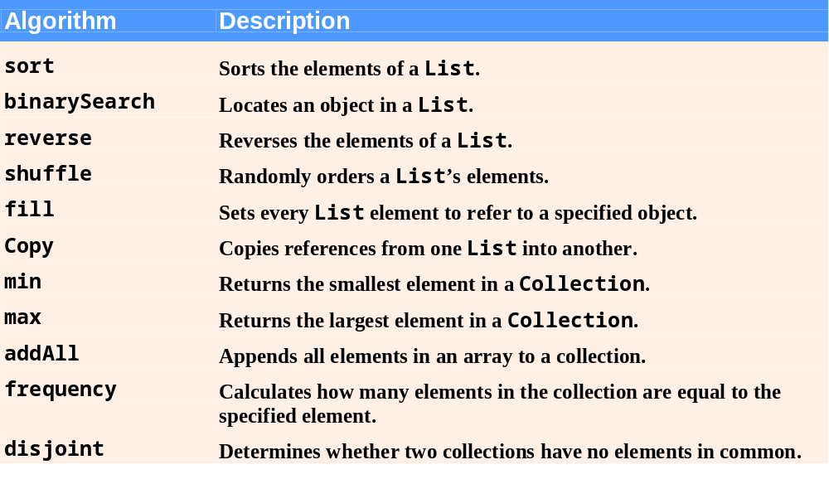
Fig. 19.7 | Collections algorithms.

Slide 50
Software Engineering Observation 19.4
The collections framework algorithms are polymorphic. That is, each algorithm can operate on objects that implement specific interfaces, regardless of the underlying implementations.

Slide 51
19.6.1 Algorithm sort
sort
  Sorts List elements
    Order is determined by natural order of elements’ type
    List elements must implement the Comparable interface
    Or, pass a Comparator to method sort
Sorting in ascending order
  Collections method sort
Sorting in descending order
  Collections static method reverseOrder
Sorting with a Comparator
  Create a custom Comparator class

Slide 52
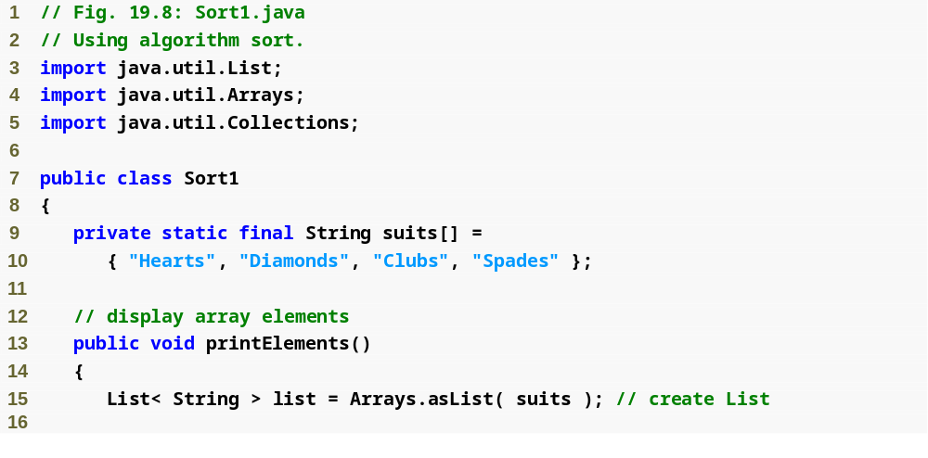
Create List of Strings

Slide 53
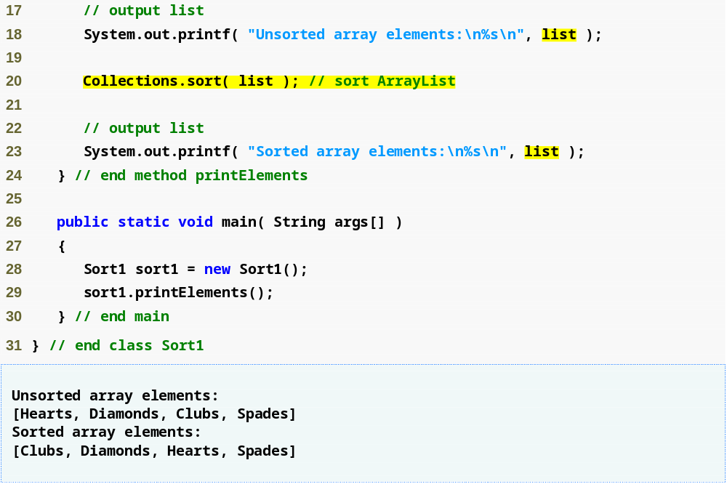
Implicit call to the list’s toString method to output the list contents
Use algorithm sort to order the elements of list in ascending order

Slide 54
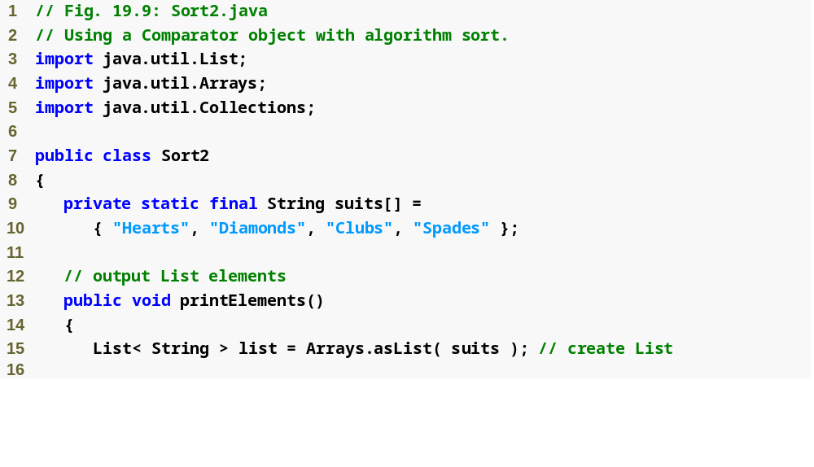

Slide 55
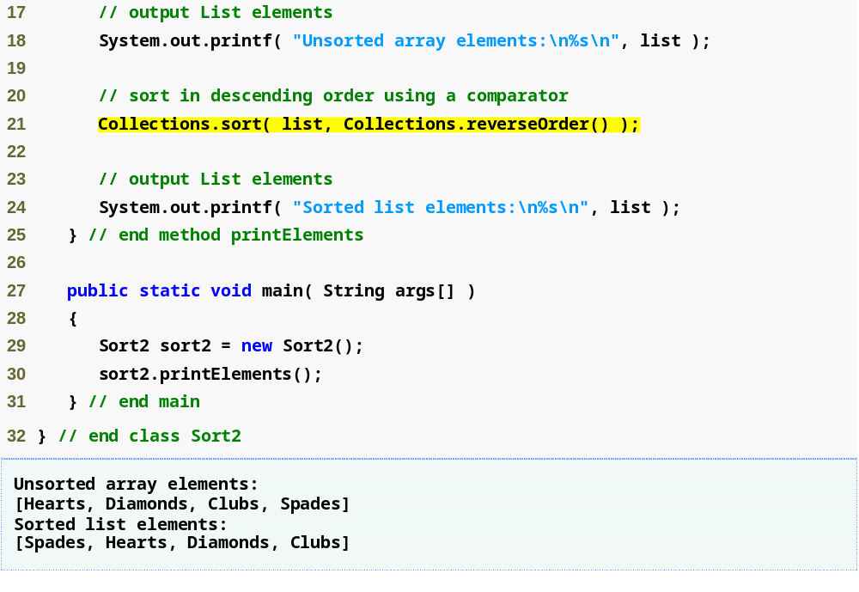
Method reverseOrder of class Collections returns a Comparator object that represents the collection’s reverse order
Method sort of class Collections can use a Comparator object to sort a List

Slide 56
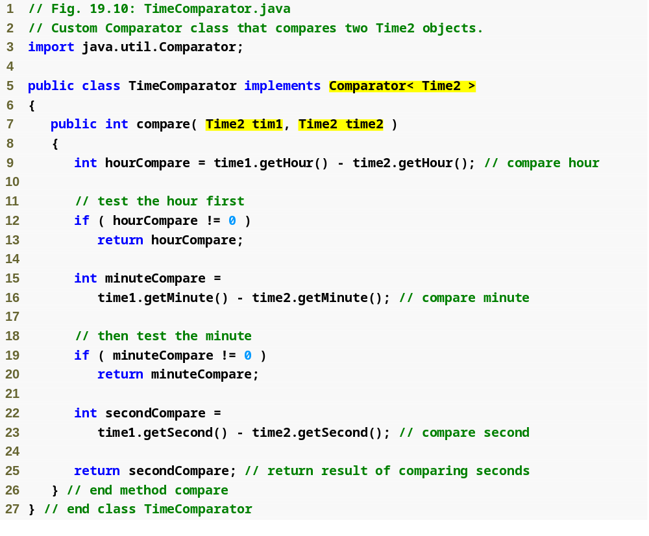
Custom comparator TimeComparator implements Comparator interface and compares Time2 object
Implement method compare to determine the order of two Time2 objects

Slide 57
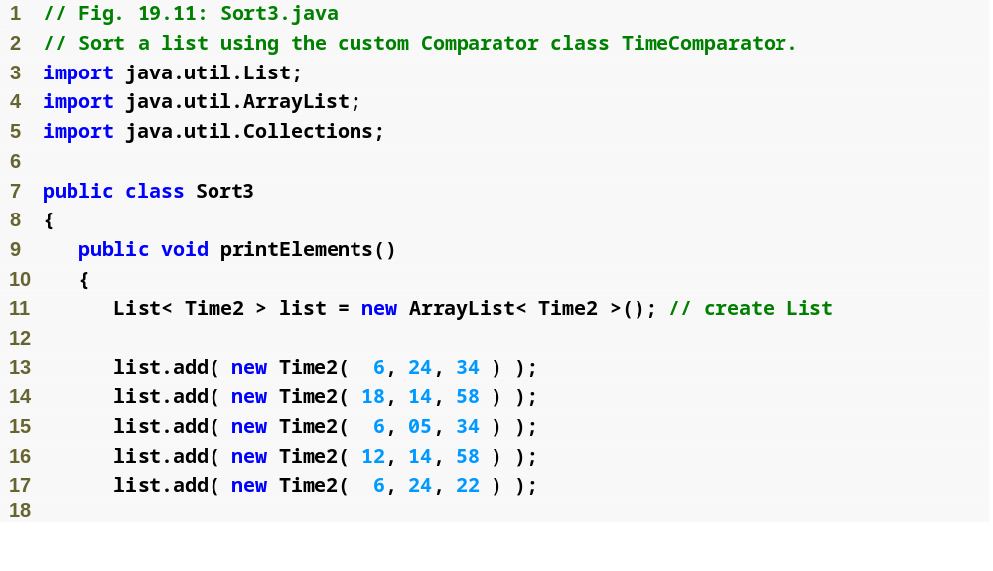

Slide 58
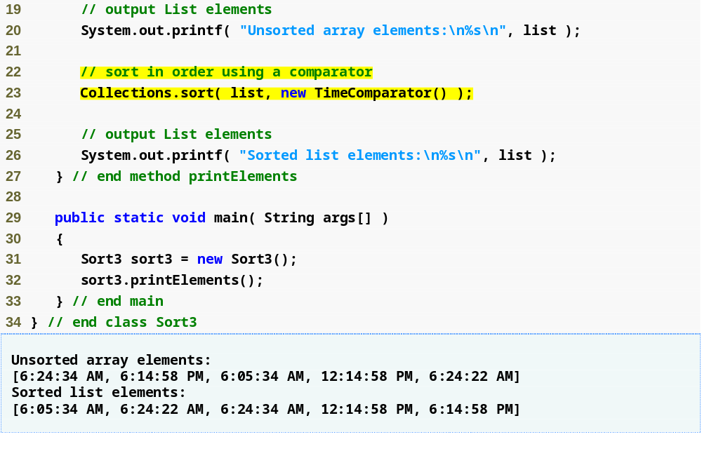
Sort in order using a custom comparator TimeComparator

Slide 59
19.6.2 Algorithm shuffle
shuffle
  Randomly orders List elements

Slide 60
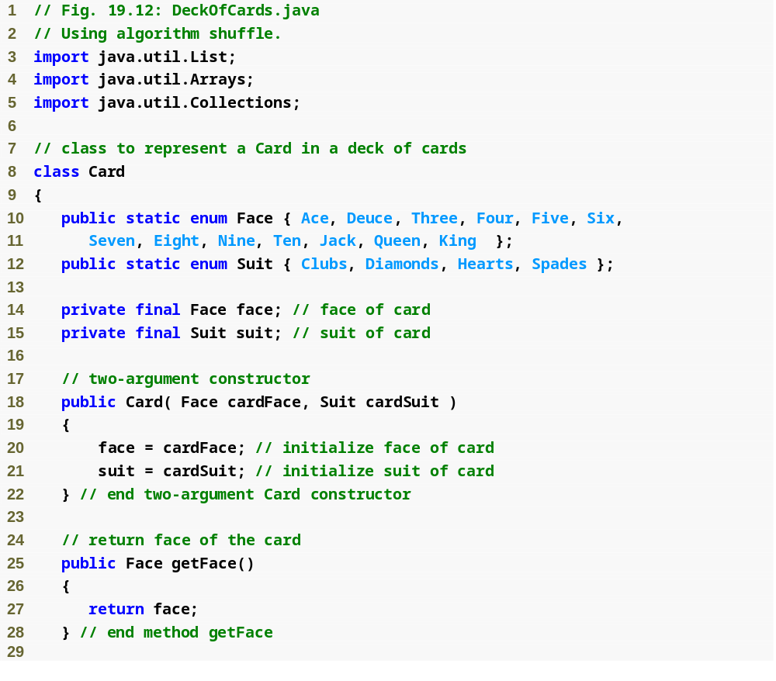

Slide 61
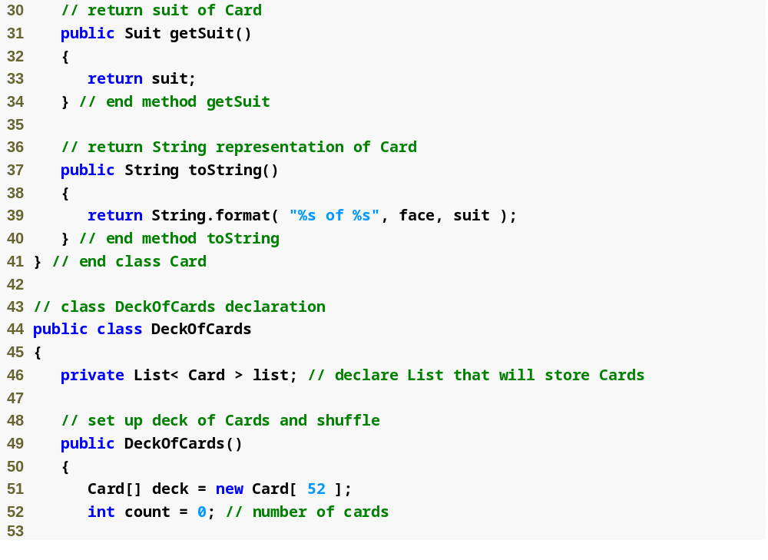

Slide 62
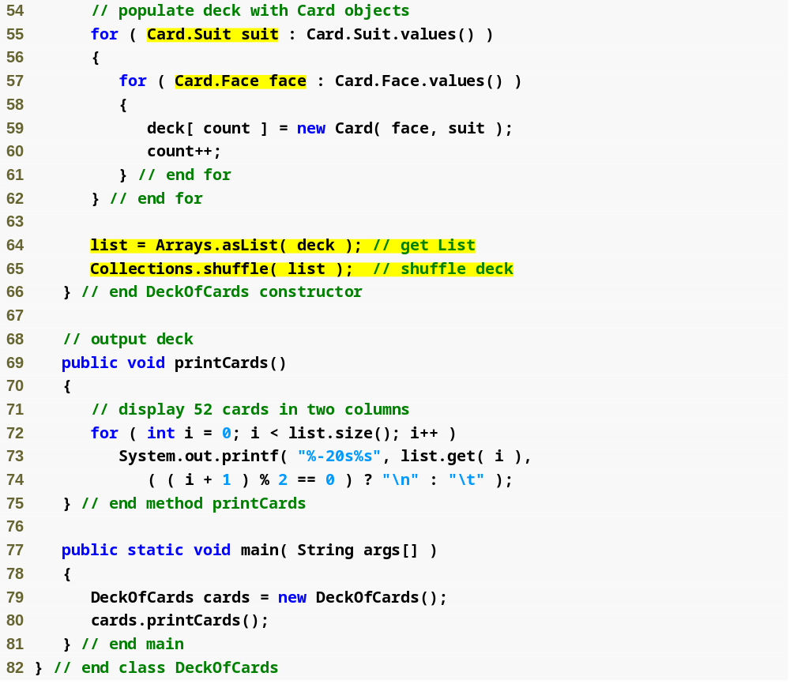
Use enum type Suit outside of class Card, qualify the enum’s type name (Suit) with the class name Card and a dot (.) separator
Use enum type Face outside of class Card, qualify the enum’s type name (Face) with the class name Card and a dot (.) separator
Invoke static method asList of class Arrays to get a List view of the deck array
Use method shuffle of class Collections to shuffle List

Slide 63
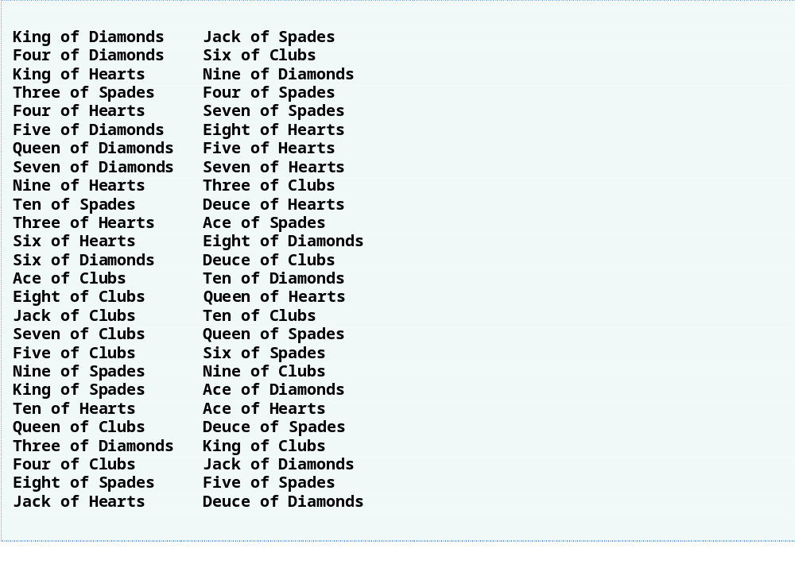

Slide 64
19.6.3 Algorithm reverse, fill, copy, max and min
reverse
  Reverses the order of List elements
fill
  Populates List elements with values
copy
  Creates copy of a List
max
  Returns largest element in List
min
  Returns smallest element in List

Slide 65
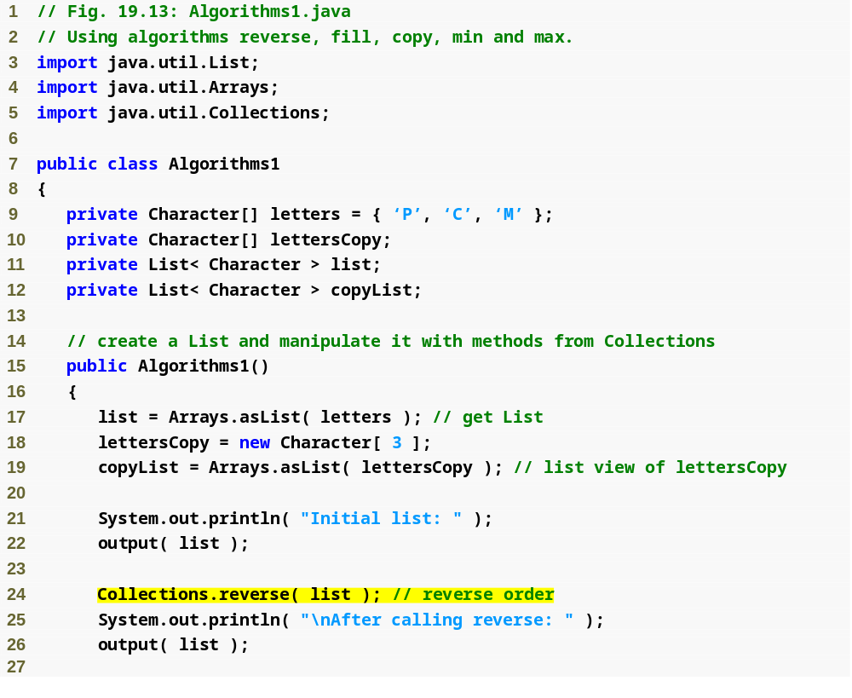
Use method reverse of class Collections to obtain List in reverse order

Slide 66
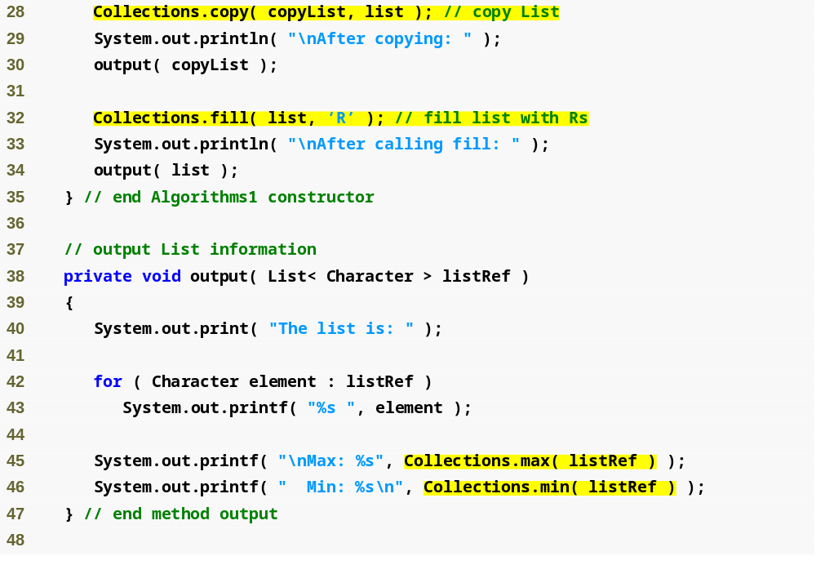
Use method copy of class Collections to obtain copy of List
Use method fill of class Collections to populate List with the letter ‘R’
Obtain maximum value in List
Obtain minimum value in List

Slide 67
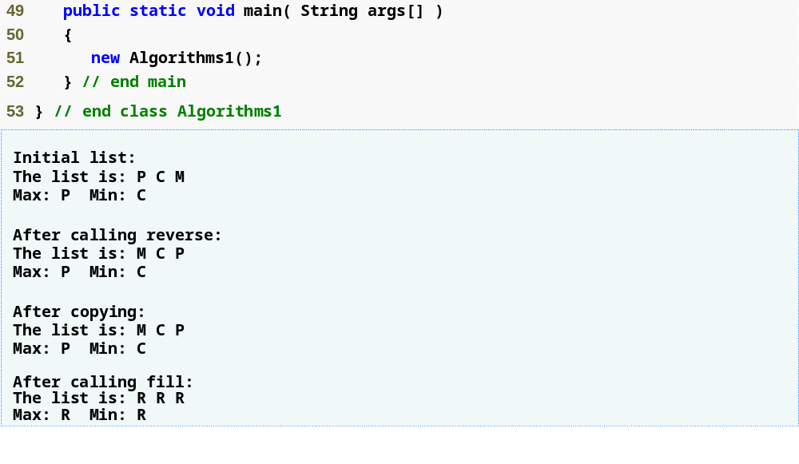

Slide 68
19.6.4 Algorithm binarySearch
binarySearch
  Locates object in List
    Returns index of object in List if object exists
    Returns negative value if Object does not exist
      Calculate insertion point
      Make the insertion point sign negative
      Subtract 1 from insertion point

Slide 69
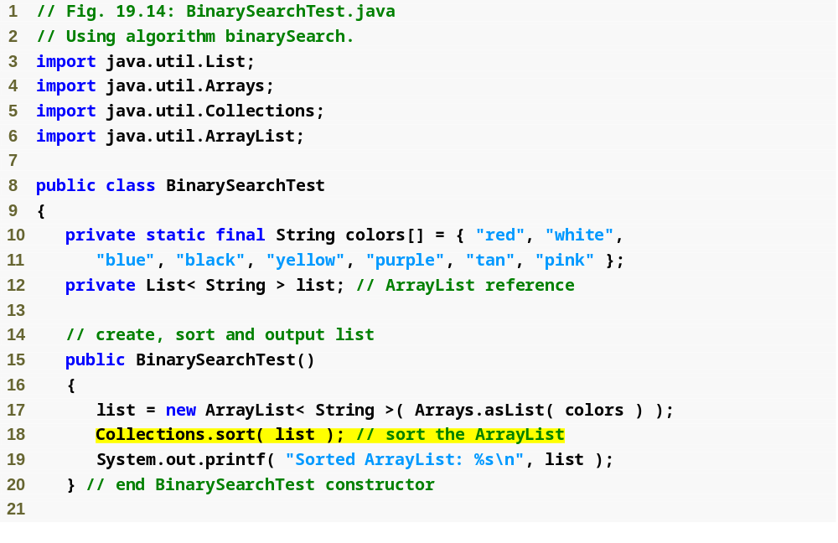
Sort List in ascending order

Slide 70
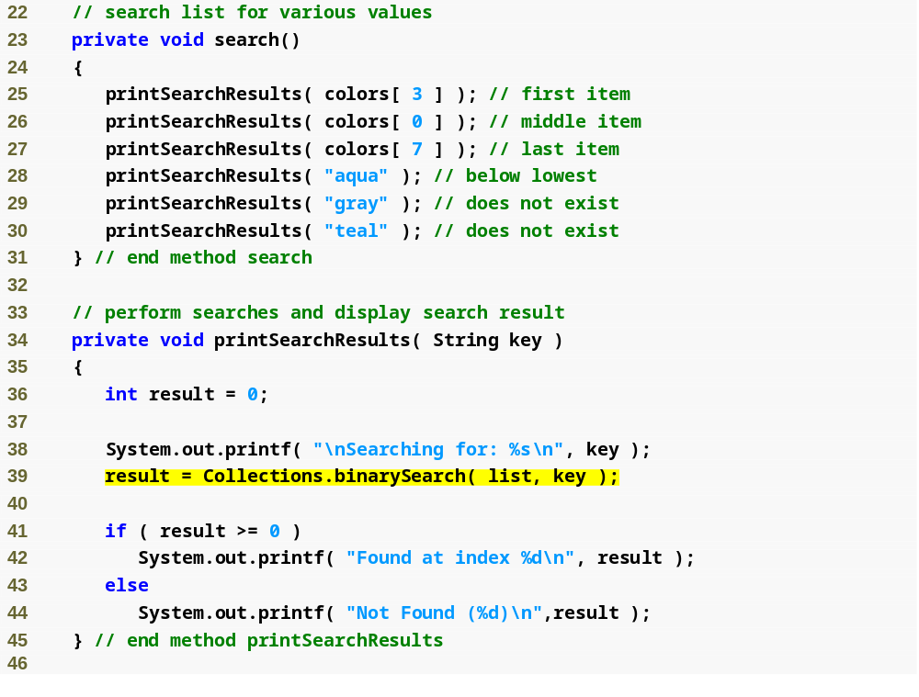
Use method binarySearch of class Collections to search list for specified key

Slide 71
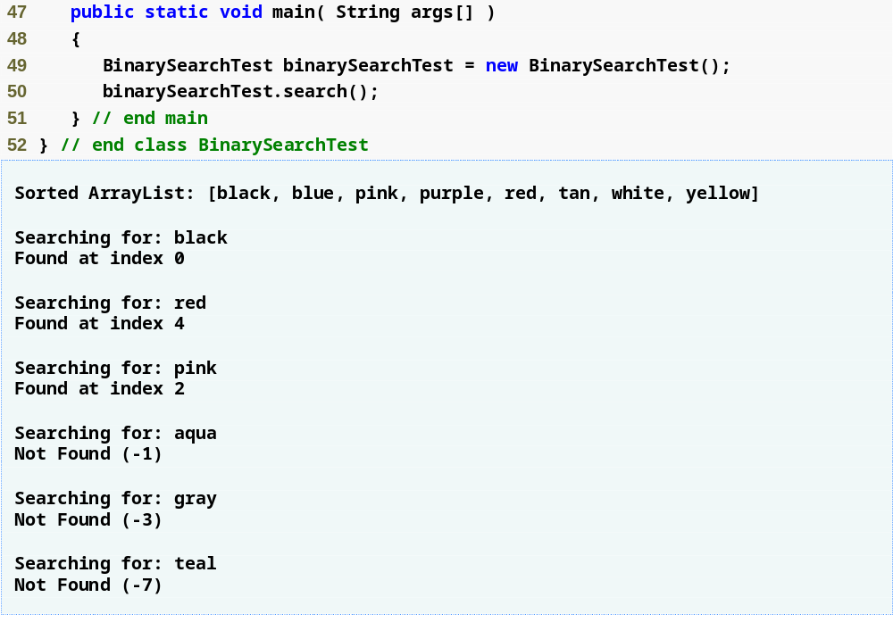

Slide 72
19.6.5 Algorithms addAll, frequency and disjoint
addAll
  Insert all elements of an array into a collection
frequency
  Calculate the number of times a specific element appear in the collection
Disjoint
  Determine whether two collections have elements in common

Slide 73
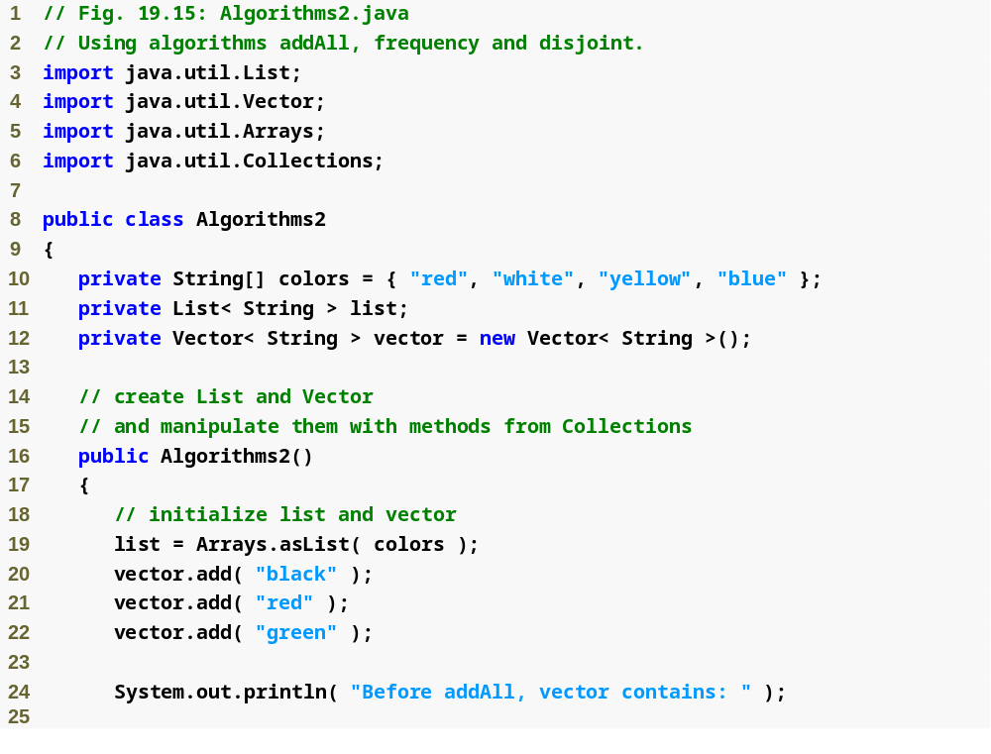

Slide 74
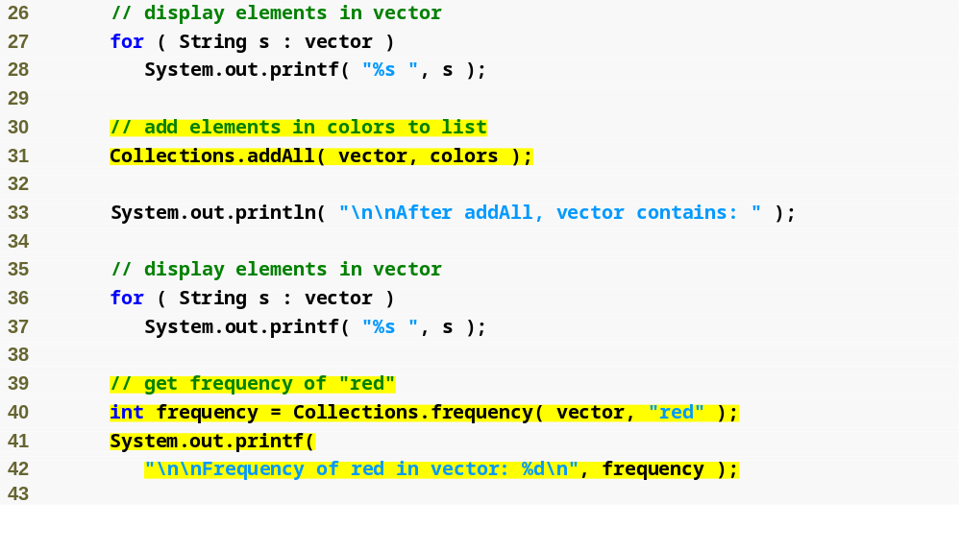
Invoke method addAll to add elements in array colors to vector
Get the frequency of String “red” in Collection vector using method frequency

Slide 75
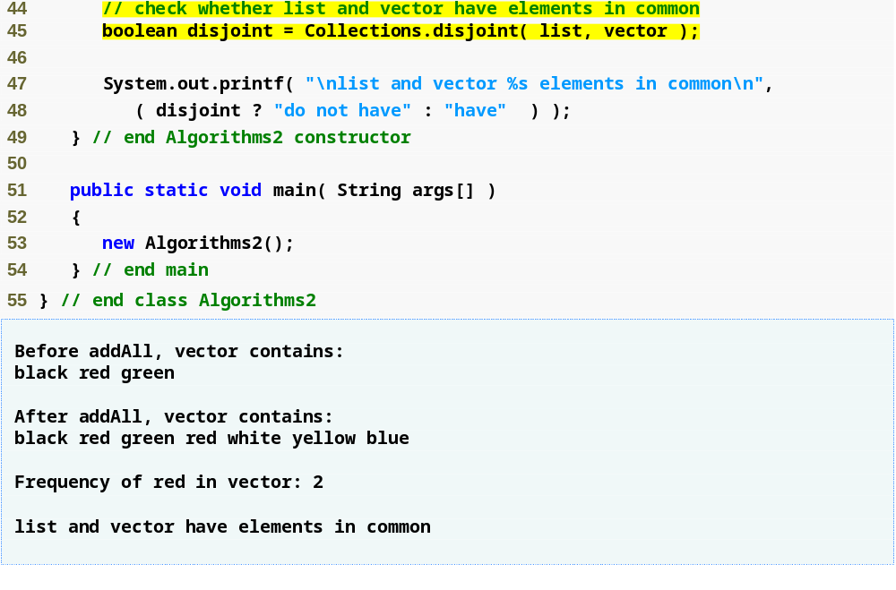
Invoke method disjoint to test whether Collections list and vector have elements in common

Slide 76
19.7 Stack Class of Package java.util
Stack
  Implements stack data structure
  Extends class Vector
  Stores references to objects

Slide 77
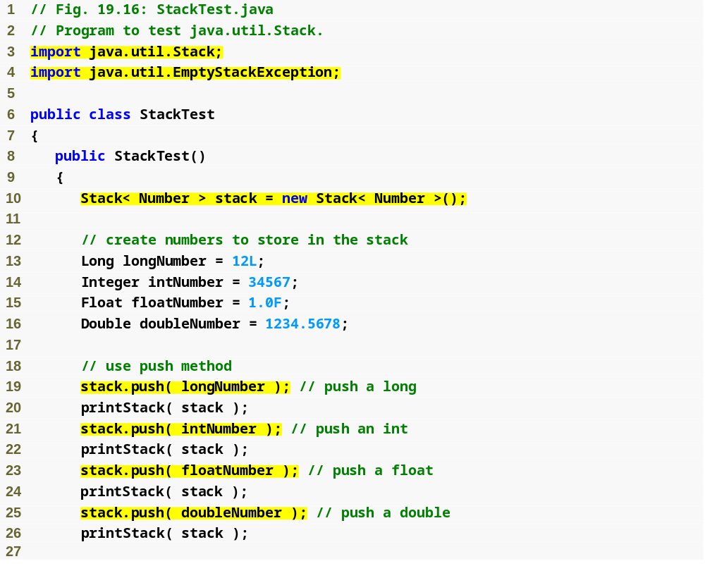
Create an empty Stack of type Number
Stack method push adds object to top of Stack

Slide 78
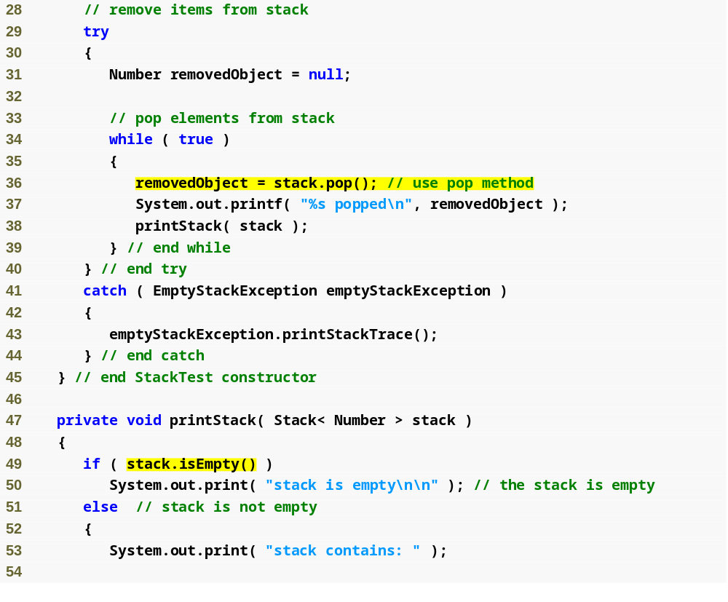
Stack method pop removes element from top of Stack
Stack method isEmpty returns true if Stack is empty

Slide 79
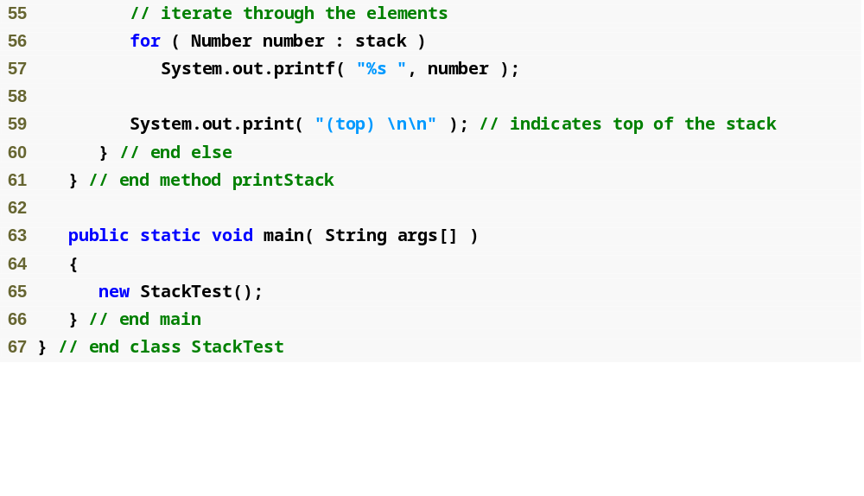

Slide 80
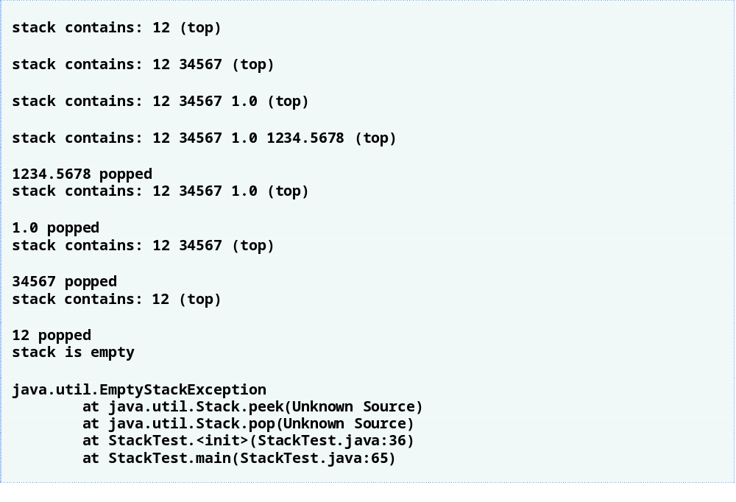

Slide 81
Error-Prevention Tip 19.1
Because Stack extends Vector, all public Vector methods can be called on Stack objects, even if the methods do not represent conventional stack operations. For example, Vector method add can be used to insert an element anywhere in a stack—an operation that could “corrupt” the stack. When manipulating a Stack, only methods push and pop should be used to add elements to and remove elements from the Stack, respectively.

Slide 82
19.8 Class PriorityQueue and Interface Queue
Interface Queue
  New collection interface introduced in J2SE 5.0
  Extends interface Collection
  Provides additional operations for inserting, removing and inspecting elements in a queue
Class PriorityQueue
  Implements the Queue interface
  Orders elements by their natural ordering
    Specified by Comparable elements’ compareTo method
    Comparator object supplied through constructor

Slide 83
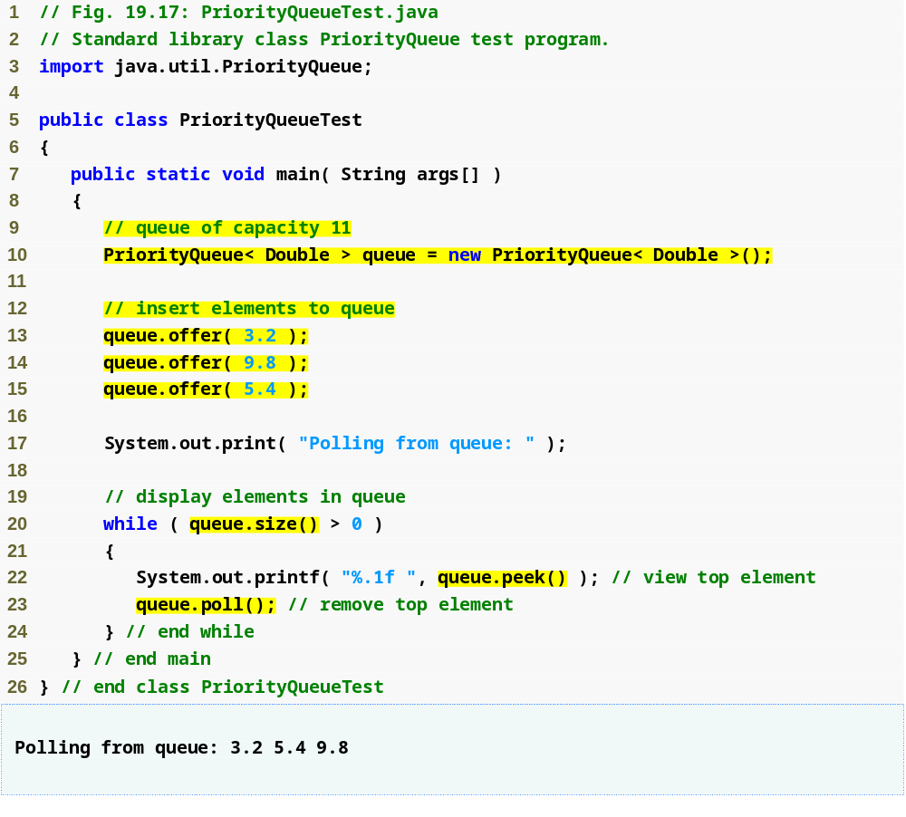
Create a PriorityQueue that stores Doubles with an initial capacity of 11 elements and orders the elements according to the object’s natural ordering
Use method offer to add elements to the priority queue
Use method size to determine whether the priority queue is empty
Use method peek to retrieve the highest-priority element in the queue
Use method pool to remove the highest-priority element from the queue

Slide 84
19.9 Sets
Set
  Collection that contains unique elements
  HashSet
    Stores elements in hash table
  TreeSet
    Stores elements in tree

Slide 85
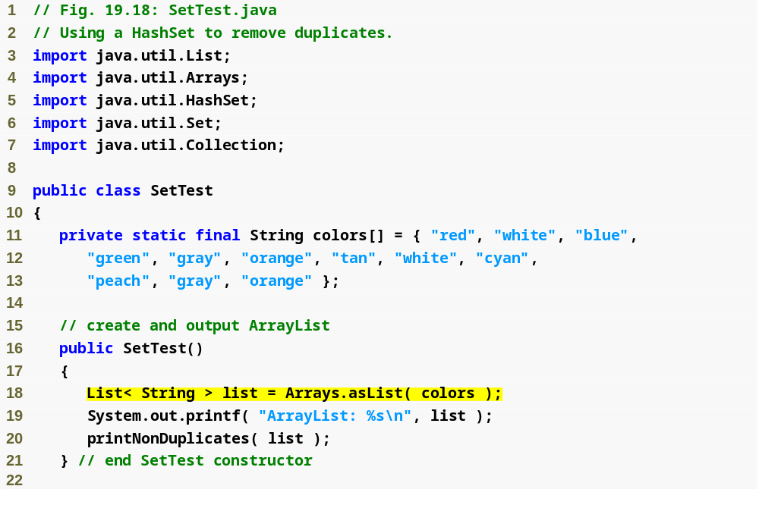
Create a List that contains String objects

Slide 86
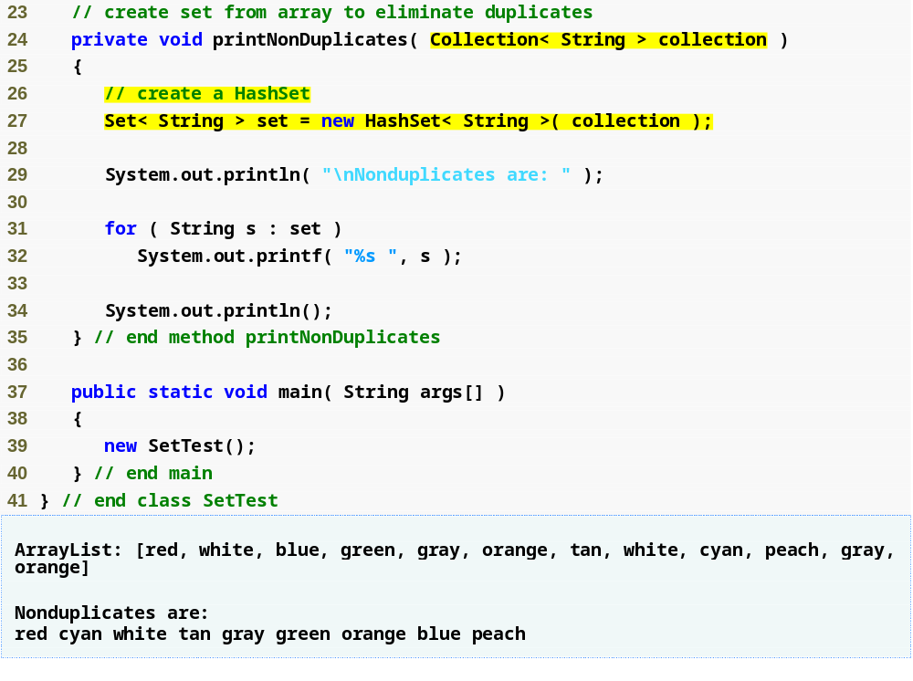
Method printNonDuplicates accepts a Collection of type String
Construct a HashSet from the Collection argument

Slide 87
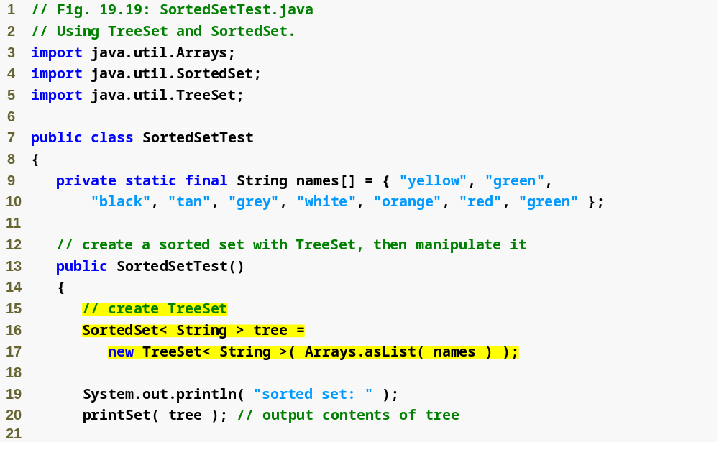
Create TreeSet from names array

Slide 88
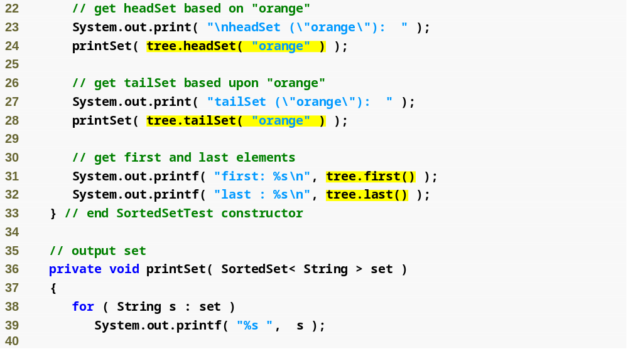
Use TreeSet method headSet to get TreeSet subset less than "orange"
Use TreeSet method tailSet to get TreeSet subset greater than "orange"
Methods first and last obtain smallest and largest TreeSet elements, respectively

Slide 89
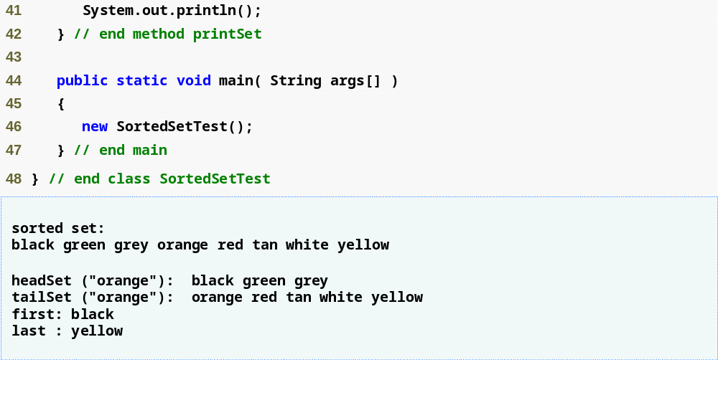

Slide 90
19.10 Maps
Map
  Associates keys to values
  Cannot contain duplicate keys
    Called one-to-one mapping
  Implementation classes
    Hashtable, HashMap
      Store elements in hash tables
    TreeMap
      Store elements in trees
  Interface SortedMap
    Extends Map
    Maintains its keys in sorted order

Slide 91
19.10 Maps (Cont.)
Map implementation with hash tables
  Hash tables
    Data structure that use hashing
      Algorithm for determining a key in table
        Keys in tables have associated values (data)
    Each table cell is a hash “bucket”
      Linked list of all key-value pairs that hash to that cell
      Minimizes collisions

Slide 92
Performance Tip 19.7
The load factor in a hash table is a classic example of a memory-space/execution-time trade-off: By increasing the load factor, we get better memory utilization, but the program runs slower, due to increased hashing collisions. By decreasing the load factor, we get better program speed, because of reduced hashing collisions, but we get poorer memory utilization, because a larger portion of the hash table remains empty.

Slide 93
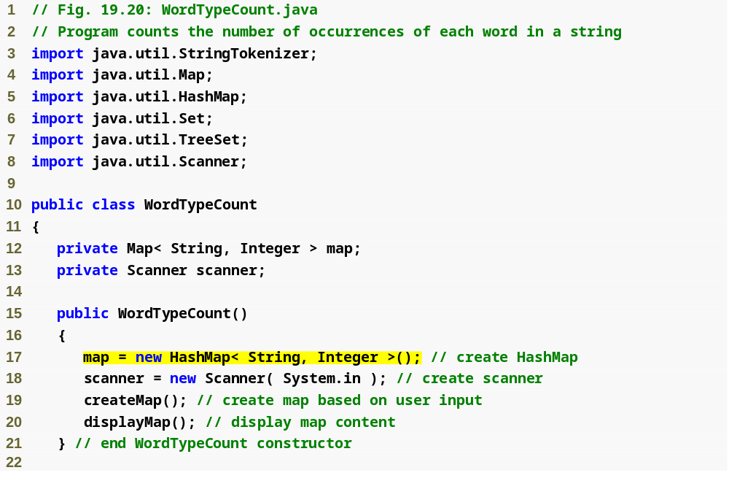
Create an empty HashMap with a default capacity 16 and a default load factor 0.75. The keys are of type String and the values are of type Integer

Slide 94

Create a StringTokenizer to break the input string argument into its component individual words
Use StringTokenizer method hasMoreTokens to determine whether there are more tokens in the string
Use StringTokenizer method nextToken to obtain the next token
Map method containsKey determines whether the key specified as an argument is in the hash table
Use method get to obtain the key’s associated value in the map
Increment the value and use method put to replace the key’s associated value
Create a new entry in the map, with the word as the key and an Integer object containing 1 as the value

Slide 95

Use HashMap method keySet to obtain a set of the keys
Access each key and its value in the map
Call Map method size to get the number of key-value pairs in the Map
Call Map method isEmpty to determine whether the Map is empty

Slide 96


Slide 97
19.11 Properties Class
Properties
  Persistent Hashtable
    Can be written to output stream
    Can be read from input stream
  Provides methods setProperty and getProperty
    Store/obtain key-value pairs of Strings
Preferences API
  Replace Properties
  More robust mechanism

Slide 98

Create empty Properties
Properties method setProperty stores value for the specified key

Slide 99

Use Properties method clear to empty the hash table
Use Properties method getProperty to locate the value associated with the specified key

Slide 100

Properties method store saves Properties contents to FileOutputStream

Slide 101

Properties method load restores Properties contents from FileInputStream
Use Properties method keySet to obtain a Set of the property names
Obtain the value of a property by passing a key to method getProperty

Slide 102


Slide 103
19.12 Synchronized Collections
Built-in collections are unsynchronized
  Concurrent access to a Collection can cause errors
  Java provides synchronization wrappers to avoid this
    Via set of public static methods

Slide 104

Fig. 19.22 | Synchronization wrapper methods.

Slide 105
19.13 Unmodifiable Collections
Unmodifiable wrapper
  Converting collections to unmodifiable collections
  Throw UnsorrtedOperationException if attempts are made to modify the collection

Slide 106
Software Engineering Observation 19.5
You can use an unmodifiable wrapper to create a collection that offers read-only access to others, while allowing read–write access to yourself. You do this simply by giving others a reference to the unmodifiable wrapper while retaining for yourself a reference to the original collection.

Slide 107

Fig. 19.23 | Unmodifiable wrapper methods.

Slide 108
19.14 Abstract Implementations
Abstract implementations
  Offer “bare bones” implementation of collection interfaces
    Programmers can “flesh out” customizable implementations
  AbstractCollection
  AbstractList
  AbstractMap
  AbstractSequentialList
  AbstractSet
  AbstractQueue

